Slide 1
Crime Victims’ Rights in Consumer Law
Friday, March 17, 2017
By Ariel Speser, Northwest Justice Project VOCA Attorney

Slide 2
Consumer Law
Advocacy for economic security for low-income and other disadvantaged people, including older adults, to stop exploitative practices, help financially stressed families build and retain wealth, and advance economic fairness.
Using the court system to prevent private debt collection abuse to preserve income and prevent asset stripping of low-income persons.

Slide 3
Having a family

Slide 4
Owning a home

Slide 5
Buying a car

Slide 6
Improving access to credit

Slide 7
Washington State Supreme Court Civil Legal Needs Study Update 2015
Notes:
-Study available at Office of Civil Legal Aid website.
-Legal aid focusing on intersection of healthcare and consumer/finance b/c widened the justice gap for people living in poverty. New consumer issues are constantly emerging due to the echoes of the recession. Unique nature of medical debt b/c bills result from services often involuntary, unplanned, unpredictable, for which price quotes rarely provided. CFPB did study on impact of medical debt on credit score and lowered by 10 points on average.
-AG ranked collection agency complaints as the number two issue raised by consumers in 2011.
-NJP reports 70% of consumer complaints it received concerned collection agencies, garnishment, and repossession (12 month period over 1,500 cases) in 2013-2014; about the same for 2014-2015. Doubled for medical debt specific cases from 2014-2015. Problems counting numbers due to identifying medical debt from collections.
-According to the Consumer Financial Protection Bureau – tens of millions came out of the mortgage and financial crisis with debts that are now in collections as a result of the crisis. Robbing Peter to pay Paul because homeowners decided to continue paying mortgage with decreasing funds while failing to pay other debts. CFPB – Medical Debt Complaints #+14,500. WA # 350. None from Jefferson. http://www.consumerfinance.gov/

Slide 8
Stacked Debt
Secured Debt | Unsecured Debt
Mortgage | Credit and Charge cards
Car | Legal or medical bills
Loans secured by household golds | Loans from friends or relatives
 | Department store and gasoline cards*

Slide 9
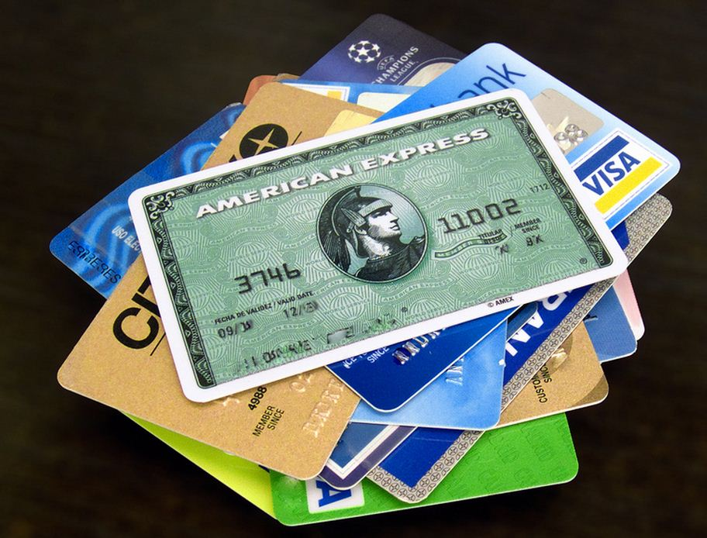
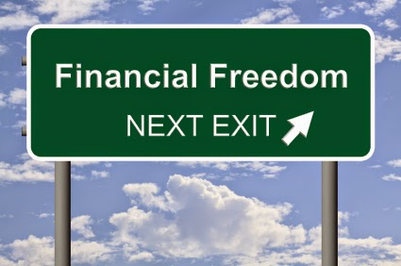
Prioritizing Debt

Slide 10
Credit Reports

Slide 11
Debt Collection
Harassment
Lawsuits
Avoiding Default
Affirmative Defenses
Garnishment & Judgments
Bankruptcy
Submit a complaint

Slide 12
Scams

Slide 13
Resources
Financial Assistance
Community Action Programs
Public Benefits
Crime Victim Compensation Fund
Consumer Law
Washington Law Help
Consumer Law Task Force
National Consumer Law Center

Slide 14
Questions?
Ariel Speser, VOCA
Northwest Justice Project
408 E. 5th Street, Port Angeles, WA 98362
206-707-0846
ariels@nwjustice.org

