Slide 1
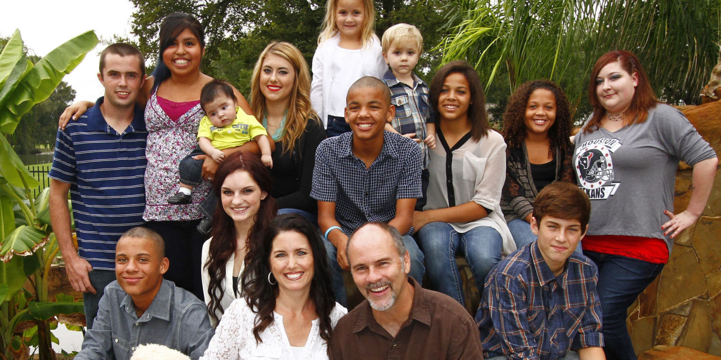
HB 1227 REALIZED: HOW TO DOMINATE SHELTER CARE IN A POST 1227 WORLD
Jeffrey Adams, Training Director, Office of Civil Legal Aid
Marci Comeau, Managing Attorney, Washington State Office of Public Defense

Slide 2
RCW 26.44.050: Law Enforcement/Protective Custody Holds
Current statute:
Abuse or neglect.
Injured or could not be taken into custody if it were first necessary to obtain a court order.
HB 1227 amendments:
Imminent physical harm due to abuse or neglect, including that which results from sexual abuse, sexual exploitation, or a pattern of severe neglect.
Seriously injured or could not be taken into custody if it were necessary to first obtain a court order.

Slide 3
RCW 26.44.056: Hospital Holds
Current statute:
Reasonable cause.
Imminent danger.
Compare with HB 1227 amendments:
Probable cause
Necessary to prevent imminent physical harm due to abuse or neglect, including that which results from sexual abuse, sexual exploitation, or a pattern of severe neglect
Seriously injured or could not be taken into custody if it were necessary to first obtain a court order.

Slide 4
RCW 13.34.050: Pick-Up Orders
Current statute:
Petition alleging child is dependent.
Reasonable grounds that child’s health, safety, and welfare will be seriously endangered if not taken into custody.
Risk of imminent harm, including, but not limited to, sexual abuse, sexual exploitation, and parent’s failure to perform basic parental functions.
HB 1227 amendments:
Petition with sufficient corroborating evidence to establish child is dependent.
Reasonable grounds to believe removal is necessary to prevent imminent physical harm due to child abuse or neglect, including that which results from sexual abuse, sexual exploitation, or pattern of severe neglect.
Specific factual information evidencing insufficient time to serve parent with petition and hold hearing prior to removal.
If child taken into custody, petition and supporting documentation must be served on parent at child’s removal unless, after diligent efforts, parent cannot be found. If parent not served, diligent efforts to personally serve parent.

Slide 5
RCW 13.34.040: Petition, Application of ICWA
Current statute:
“Is or may be an Indian child…”
HB 1227 amendments:
“Reason to know child is or may be an Indian child…”
If reason to know, ICWA applies.
Petition verified, contain statement constituting dependency, and include names/residence/ contact information (if known to petitioner) of each parent/guardian/custodian.
If petitioner seeking removal, clear and specific statement as to harm if child remains in care of parent/ guardian/custodian, and facts supporting conclusion.

Slide 6
RCW 13.34.060: Removals Prior to Shelter Care Hearing
Current statute:
Priority placement with relative or suitable adult, pending court hearing.
“Effort within available resources” to place on next business day.
Department may authorize evaluations/routine and necessary medical care.
HB 1227 amendments:
Unless reasonable cause based upon specific evidence, priority placement with relative or suitable adult.
“Continuing efforts” to place on next business day.
Department may authorize evaluations/routine and necessary care of child, after informing parent, unless parent cannot be reached.
Child’s parent must be provided opportunity to attend, unless prohibited by court order.

Slide 7
RCW 13.34.062: Notice
Current statute: Reasonable efforts.
To inform child has been taken into custody, reasons why, and legal rights (including right to shelter care hearing).
To investigate whereabouts of parent.
HB 1227: Diligent efforts.

Slide 8
RCW 13.34.065(1)(a): Continuance of 72-hour Shelter Care Hearings
Current statute:
Upon request of parent, guardian, or custodian.
Good cause and inability to attend shelter care hearing.
Subsequent shelter care hearing.
HB 1227 amendments:
Upon request of child’s attorney, parent, guardian, or custodian.
Good cause and inability to attend, or inability to adequately prepare for shelter care hearing.
Continuance of initial shelter care hearing or subsequent shelter care hearing.
If parent, guardian, or custodian is not represented by counsel, clerk shall provide information regarding how to obtain counsel.

Slide 9
Issue 1: Removal from a Parent or Guardian

Slide 10
New Removal Standard
1
Imminent physical harm due to child abuse or neglect
2
causal relationship between particular conditions in home and imminent physical harm to child;
3
Contrary to welfare to return/remain home;
Part 1

Slide 11
New Removal Standard
4
Imminent physical harm outweighs harm of removal;
5
Whether participation by parent in prevention services would prevent/eliminate need for removal;
6
Parent agrees to participate in prevention services.
Part 2

Slide 12
What is not imminent physical harm?
Community or family poverty
Isolation
Single parenthood
Age of the parent
Crowded or inadequate housing
Substance abuse
Prenatal drug or alcohol exposure
Mental illness
Disability or special needs
Nonconforming social behavior
Mental Illness
Poverty
Substance Abuse
Disability

Slide 13
Prevention Services vs. Remedial Services
Services
Preventative
Remedial
Services capable of preventing need for out-of-home placement while protecting child.
Safety planning.
Preservation services.
Housing assistance.
Specific mental health prevention and treatment services, substance abuse prevention and treatment services, and in-home parent skill-based programs that qualify for federal funding under the federal family first prevention services act.
Family reunification services that facilitate reunification of child safely and appropriately within a timely fashion.
Case Planning.
Remedial services include individual, group, and family counseling; substance abuse treatment services; mental health services; assistance to address domestic violence; services designed to provide temporary childcare and therapeutic services for families; and transportation.

Slide 14
Issue 2: Placement with a Relative

Slide 15
RCW 13.34.065(5)(c): Relative Placement
PRESUMPTION of relative placement: Court shall place with relative or suitable adults unless:
Reasonable cause to believe that placement in foster care is necessary to prevent imminent physical harm (SAME AS SHELTER CARE REMOVAL STANDARD)
Because no relative or other suitable person is capable of ensuring the basic safety of the child
OR
Efforts to reunite will be hindered
Burden of proof on petitioner

Slide 16
RCW 13.34.065(5)(c)(ii): Court’s Inquiry Into Relative Placement Options
New line of court inquiry: at 72-hour shelter care hearing, the Court shall inquire whether relative or suitable person:
Has expressed interest in becoming caregiver for child;
Is able to meet any special needs of child;
Is willing to facility child’s sibling and parent visitation if ordered by court;
Supports reunification of parent and child once reunification can safely occur.
Court shall give great weight to stated preference of parent, guardian, or legal custodian, and the child.

Slide 17
RCW 13.34.065(5)(c)(iii): Relative Placement: Factors Not Preventing Placement
The following factors/issues must NOT prevent child’s placement with relative/suitable adult:
Incomplete Department or fingerprint-based background check, if relative or suitable adult appears suitable and competent, but background check must be completed as soon as possible after placement;
Uncertainty on part of relative/suitable adult regarding adoption;
Disbelief on part of relative/suitable adult that parent presents a danger to the child, provided caregiver will protect the safety of child and comply with court orders regarding parent-child contact;
Conditions of relative/suitable adult’s home are not sufficient to satisfy requirements of licensed foster home.
Court may order Department to provide financial or other support to ensure safe conditions in the home.

Slide 18
RCW 13.34.065(5)(i): Relative Placement: Initial Foster Care License
If court places with relative or suitable adult, and placement wishes to be a licensed foster parent, court shall order Department to begin initial assessment within 10 days.
If relative or suitable adult is qualified, Department shall issue an initial license and begin making foster care payments after 10 days, beginning on date Department approves initial license.
If relative or suitable adult unqualified, Department shall report to court within one week of decision.
Department shall also report on status of licensure process during entry of dispositional orders.
72 Hour Hearing
Ten Days
Licensure

Slide 19
Issue 3: Placement in Foster Care

Slide 20
RCW 13.34.065(j): Court Authority Over Foster Care Placement (the fight continues)
If court places child in foster care, Department SHALL report to court, at shelter care hearing, location of licensed foster placement identified by Department.
NEW court authority to over Department’s ability to place in foster care, including:
Ordering placement in less restrictive placement;
Ordering Department to place in location in closer proximity to child’s parent, home, or school;
Ordering Department to place with child’s siblings; and
Taking any other necessary steps to ensure the child’s health, safety, and well-being.

Slide 21
Enforcement

Slide 22
RCW 13.34.065(j)(iii): Department’s compliance and impact on reasonable efforts
Department’s failure to comply with court orders in shelter care may be considered when determining whether reasonable efforts have been made by Department at dispositional hearing.
Placement moves in shelter care may be considered when determining whether reasonable efforts have been made by Department during dispositional hearing.

Slide 23
QUESTIONS?
COMMENTS?
THANK YOU!
Jeffrey Adams, Training Director, Office of Civil Legal Aid: jeffrey.adams@ocla.wa.gov
Marci Comeau, Managing Attorney, Washington State Office of Public Defense: marci.comeau@opd.wa.gov

