Slide 1
How to Litigate Race Bias in Dependency Cases: Systemic Racism and the Child Welfare System 19 November 2020 Webinar

Slide 2
Data and Context
Jill Malat
Children’s Representation Program Manager
Jill.Malat@ocla.wa.gov

Slide 3
Placement Exceptions (Office of the Family and Children’s Ombuds, DCYF Use of Hotels and Offices as Placements) 2019 Report
September-August:
2020: 1863 days
2019: 1514
2018: 1090
2017: 824
African American or Black: 16.4% (9.2% of children in state care)
American Indian or Alaska Native: 1.8% (4.9% of children in state care)
Asian or Hawaiian/Pacific Islander: 2.3% (2.3% of children in state care)
Caucasian: 57.7%: (62.9% of children in state care)
Multi-Racial: 21.4 (20.4% of children in state care)
Hispanic: 11.4% (19.7% of children in care)

Slide 4
Data from 2019 Washington State Child Welfare Racial Disparity Indices Report DCYF

Slide 10
Washington State Office of Public Defense
Cultural Humility and Transforming Scripts of Inequality
2020 KIDS COUNT Data Book Interactive Washington Data
Foster Care Statistics
Racial Disparities Plague Foster Care in America
Disparate Policing and Child Welfare Referrals
The Cumulative Prevalence of Parental Termination
https://opd.wa.gov/

Slide 11
How to litigate race bias in dependency cases: Systemic Racism and the Child Welfare System

Slide 12
We must widen our gaze

Slide 13
“We don’t know who it was that discovered water, but we’re pretty sure it wasn’t a fish.” – John Culkin

Slide 17
Things to avoid in litigating race in Dependency cases:
1. Calling people racist without proper evidence
2. Asking for Relief the Court Cannot Grant
3. Calling the Court Racist without proper context
4. Don’t assume it’s going to be obvious

Slide 18
Litigation tools and strategies
Use your discovery tools
Go the extra few steps after you’ve mapped out concerns on a case:
“Gang involvement”
“Excellent job of preserving culture”
“Dusty, dirty, dangerous and filled with cartels”
SW during trial testifying about relative placement
Allow the Court to make the final connection

Slide 19
Don’t sabotage your own momentum
1 . Create allies in your litigation
Commission on Hispanic affairs
Commission on African American affairs
Disability Rights Groups
2. Don’t ask for relief that the court cannot grant
Removal of the social worker
Racism training of the social worker

Slide 20
Resources for understanding Race in a different way
1. The origin of others- Toni Morrison
2. The condemnation of blackness: Race, Crime and the making of modern urban America
3. The Souls of Black Folk- W.E.B. Du Bois
4. Building a black criminology, Volume 24 Race, Theory and Crime- James D. Unnever
5. A different mirror- Ronald Takaki
6. The fire next time- James Baldwin
7. How to be an anti-racist- Ibram x. Kendi
8. The new jim crow: mass incarceration in the age of colorblindness- Michelle Alexander
9. White Fragility: why it’s so hard for white people to talk about Racism- Robin Diangelo
10. Democracy in black: how race still enslaves the American soul- Eddie s. Glaude jr.
11. However Kindly Intentioned: Structural Racism and CASA programs by Attorneys Tara Urs and Amy Mulzer
Law Review article available for download online and part of this CLE handout

Slide 21
More Ideas for Litigating Race Bias
Ms. D’Adre Cunningham, WDA IPP Resource Attorney &
Nancy Talner, American Civil Liberties Union of Washington Staff Attorney

Slide 22
Roadmap
History of U.S. Family Regulation System is Steeped in Racial & Other Bias
Selected Past Strategies to Remediate Explicit Racial Bias
Community & Family Cultural Responses to Past Harms Exist
Advocacy Ideas for Elevating Issues of Bias and Harms

Slide 23
Takeaways
Racial bias causes harm to children, parents, and loved ones in the family regulation system, which is historical and ongoing
Laws alone are not be sufficient to protect children against racial bias
Cultural responses to racial bias are under attack
Litigate racial bias and its harms

Slide 24
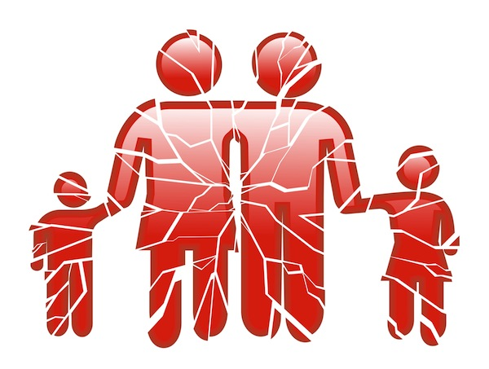
Acknowledging Harms Caused by Racial Bias
Acknowledgment
Name the wrong
Request the remedy
Problem-solving
Individual level
Interpersonal or Family level
Community level
Notes:
Understanding the original purposes of the family regulation system makes advocacy more effective for all clients
Noting the harms caused by the system provides creative advocacy strategies
Developing “no harm” solutions requires collaboration with people who lived through these experiences

Slide 25
Historical Racial Bias in the U.S.
Black & Indigenous groups in particular experienced mass family disruption with the express intention of stripping away family, tribal or ethnic culture of origin (languages, faiths, beliefs and traditions) in order to replace it with government- sanctioned cultural identity and for longer than other groups.
https://www.loc.gov/classroom-materials/immigration/
https://www.zinnedproject.org/materials/indigenous-peoples-history-of-the-us/
Notes:
Members of racial groups share experiences based on historical and ongoing treatment by the government and social (any nongovernmental) institutions by race.
Race is not tribe or ethnicity, but members of the same racial group may share cultural traits, traditions, and beliefs based on their shared experiences. For example, Black is a race; Gullah is an ethnicity. (See http://www.beaufortsc.org/guides/gullah-history/) or “American Indian” or “Native American” is a racial group; Yakama is a tribe. (See https://www.yakama.com/about/).
Oxford Reference definition from the Oxford Dictionary of Philosophy: https://www.oxfordreference.com/view/10.1093/oi/authority.20110901080526139#:~:text=The%20way%20of%20life%20of,The%20Oxford%20Dictionary%20of%20Philosophy%20%C2%BB
The way of life of a people, including their attitudes, values, beliefs, arts, sciences, modes of perception, and habits of thought and activity. Cultural features of forms of life are learned but are often too pervasive to be readily noticed from within.
Merriam-Webster dictionary definition is longer: https://www.merriam-webster.com/dictionary/culture
Culture is The customary beliefs, social forms, and material traits of a racial, religious, social group; also the characteristic features of everyday existence (such as diversions or a way of life) shared by people in a place or time.
Bibliography

Slide 26
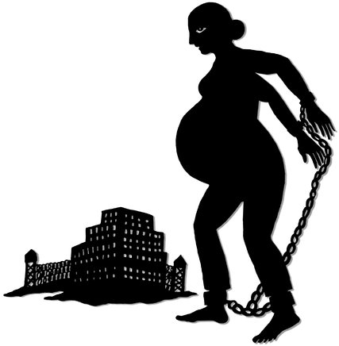
Historical Harms through Family Regulation
Examples:
Displacement of families from their lands
Removing parents and loved ones from children and removing children from their parents and loved ones during slavery
Forced adoptions, forced placement in orphanages, workhouses, boarding schools, and forced assimilation practices
Notes:
*Personal autonomy is part of the fundamental, sacred rights protected by the 14th Amendment. For e.g., the decision-making over where children live, what faith they practiced, what language they speak, what cultural traditions they learn or practice, with whom they socialize, and where and how they are educated.
See Roberts, Dorothy. Killing the Black Body: Race, Reproduction, and the Meaning of Liberty. Random House: (1998).
https://theconversation.com/the-long-history-of-separating-families-in-the-us-and-how-the-trauma-lingers-98616
Removing Native Americans from their Land. Library of Congress materials with links for other groups: https://www.loc.gov/classroom-materials/immigration/native-american/removing-native-americans-from-their-land/
Explore the collections of the National Museum of African American History & Culture:
https://nmaahc.si.edu/explore/collection/search?edan_q=%2A%3A%2A&edan_local=1&edan_fq[]=topic%3A%22Slavery%22

Slide 27
Past Strategies to Remediate Harms
Indian Child Welfare Act (25 U.S.C. § 1901) & WA Indian Child Welfare Act (Chapter 13.38 RCW)
Not all Indigenous people are protected.
Strategy centers around sovereign tribes and their political power
The legal strategy to protect Black children from removal and assimilation has essentially failed. There is no protective legal entity or mechanism.
Current federal law views the prevention of Interethnic Adoption as a violation of Title VI of the Civil Rights Act of 1964
Notes:
No equivalent to ICWA/WICWA for Black people, instead Congress passed Multi-Ethnic Placement Act of 1994 & the Removal of Barriers to Interethnic Adoption Act (IEP) of 1996. Violation of these provisions are a violation of Title VI of the Civil Rights Act of 1964. For a review of implementation, see The Multiethnic Placement Act Minorities in Foster Care and Adoption. (https://www.usccr.gov/pubs/docs/MEPABriefingFinal_07-01-10.pdf)

Slide 28
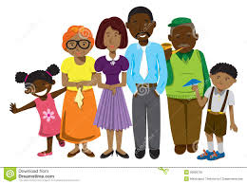
Cultural Responses to Harm Matter
Child-rearing involves family and loved ones alongside parents and not only blood relatives
Family and community culture can teach how to form healthy racial identity and how to live/endure racism in the U.S.
Does DCYF prefer really parental placement, relative or suitable adult placement in practice?

Slide 29
Advocacy Ideas
litigate racial bias when explicit and implicit
use of qualified experts
motions practice
target key decision points for advocacy (removal, placement, visitation, wellness, social, cultural and education)
seek removal of and file grievance against VGAL/CASA, when needed
Notes:
Caregivers of Black children should be individually considered for whether they can provide environment that assist the child in developing a healthy and supported racial identity.
Even when prospective adoptive families mean well, they can, inadvertently reinforce white racial hierarchies.
DCYF uses reasons for denying parental placement and placement with loved ones that are based on racial bias.
Notes:
Links to amici curiae briefs filed in ZMG, SCOW No. 98003-9. Available at: https://www.courts.wa.gov/appellate_trial_courts/coaBriefs/index.cfm?fa=coabriefs.searchRequest&courtId=A08
Starting point for law reviews and social science:
Miller, Marna. Racial Disproportionality in Washington State’s Child Welfare System. Olympia, Washington: Washington State Institute for Public Policy, Document No. 08-06-3901, 7-9 (2008). Available at: https://www.wsipp.wa.gov/ReportFile/1018/Wsipp_Racial-Disproportionality-in-Washington-States-Child-Welfare-System_Full-Report.pdf.
Darron T. Smith, et al., White on black: Can white parents teach black adoptive children how to understand and cope with racism?, 42(8) Journal of Black Studies 1195-1230 (2011). Available at: https://www.researchgate.net/publication/51881495_White_on_Black_Can_White_Parents_Teach_Black_Adoptive_Children_How_to_Understand_and_Cope_With_Racism
Tanya Washington, Loving Grutter: Recognizing Race in Transracial Adoptions, 16 Geo. Mason U. Civ. Rts. L.J. 1, 4 (2005)(“[W]ell-meaning and loving transracial adoptive parents can still be ill-equipped to provide effective parenting for their child's societally imposed racial identity.”). Professor Washington argues for a mandatory racial competency training program designed to preserve and promote the best interest of transracial adoptees and analyzes the constitutionality of such a program. Available on Westlaw.
Twila L. Perry, Power, Possibility and Choice: The Racial Identity of Transracially Adopted Children, 9 Mich. J. Race & L. 215, 216 (2003) (“[T]o place Black children for adoption without considering the issues they will inevitably confront growing up in a racist society is a disservice to the children.”). Available at: https://repository.law.umich.edu/cgi/viewcontent.cgi?article=1158&context=mjrl.
Judicial Decision-making
Andrew J. Wistrich et. al., Heart Versus Head: Do Judges Follow the Law or Follow Their Feelings?, 93 Tex. L. Rev. 855, 911 (2015) (“Research shows that “when the law is unclear, the facts are disputed, or judges possess wide discretion their decisions can be influenced by their feelings about litigants.”).
National Council of Juvenile and Family Court Judges (NCJFCJ), Addressing Bias in Delinquency and Child Welfare Systems: Eliminating Racial and Ethnic Disparities in Juvenile and Family Courts Is Critical to Creating a Fair and Equitable System of Justice for All Youth, (2018). Available at: https://njdc.info/wp-content/uploads/2018/07/Addressing-Bias-Bench-Card-1.pdf)

Slide 30
Role of Amicus Briefs in Cases Involving Racial Bias
Connect
data
history
policy to
legal issues

Slide 31
Dependency of ZJG
“In Native American communities across the country, many families tell stories of family members they have lost to the systems of child welfare, adoption, boarding schools, and other institutions that separated Native children from their families and tribes. This history is a living part of tribal communities, with scars that stretch from the earliest days of this country to its most recent ones.”
Notes:
In the Matter of the Dependency of Z.J.G. and M.E.J.G.,

Slide 32
Dependency of ZJG
“The states’ widespread removal of Indian children without notice presented a serious threat not only to the family and children but also to the existence of tribes as self-governing communities.
“This trauma was particularly widespread in Washington.”
“To ignore that history and its impacts on today’s child welfare system in Washington and elsewhere undermines the purposes of ICWA (and WICWA).”
Notes:
Court’s opinion filed (https://www.courts.wa.gov/opinions/pdf/980039%20rev.pdf)
SCOW No. 98003-9 - In the Matter of the Dependency of Z.J.G. and M.E.J.G., minor children.
Links to amici curiae briefs filed in ZJG, available at: https://www.courts.wa.gov/appellate_trial_courts/coaBriefs/index.cfm?fa=coabriefs.searchRequest&courtId=A08
Amicus - Margaret Jacobs in Support of Petition for Review
Amicus - American Indian Law Professors, et al
Amicus - Children's Tribes
Amicus - Youth and Children, et al
Supplemental Amicus Children's Tribes
Amicus - American Indian Law Professors, Center for Indian Law & Policy, et al

Slide 33
Dependency of AK
Whether in this dependency action, the Court of Appeals erroneously applied the invited error doctrine to decline to review the mother’s argument that the Department of Children, Youth, and Families failed to comply with the “active efforts” requirement of the federal and state Indian Child Welfare Acts, and if so, whether the department failed to make active efforts to provide services and programs to the mother to prevent the breakup of her family.
No. 98487-5, In re the Dependency of A.K., L.R.K.S., & D.B.K.S. (Oral argument 10/29/20)

Slide 34
Dependency of GJA
Whether in this dependency proceeding involving Indian children, a parent, by signing an agreed dependency review order stating that the State has made “active efforts” to provide services to prevent breakup of the Indian family as required by the federal Indian Child Welfare Act and its Washington counterpart, waives the right to challenge whether the State has met the active efforts requirement, and if not, whether the State made active efforts in this case.
No. 98554-5, In Re the Dependency of G.J.A., A.R.A., S.S.A., J.J.A., and V.A.
(will be argued soon)

Slide 35
In Re KW
“Forced family separation—of which the foster care system is the most recent iteration—is a relic of slavery, wherein the State used the courts to rip Black families apart and ignored their pleas of reunification. Family separation is also a continuation of the devastating and genocidal legacy of colonization.”
““[k]inship care is a viable component of family preservation, reunification and permanency for African American children[,]” while a governmental preference for a white nuclear family as a placement for a Black child raises serious questions about racial bias.”
Notes:
Quote#1- Holden, Vanessa M., Slavery and America’s Legacy of Family Separation. African American Intellectual History Society (July 25, 2018)(https://www.aaihs.org/slavery-and-americas-legacy-of-family-separation/). Cf. Christina White, Federally Mandated Destruction of the Black Family: The Adoption and Safe Families, 1 Nw. J. L. & Soc. Pol'y. 303, 304-305 (2006) (https://scholarlycommons.law.northwestern.edu/cgi/viewcontent.cgi?article=1003&context=njlsp).
Quote #2-Robert B. Hill, Ph.D., Zelma S .Smith, and Jacqueline Bailey Kidd, Kinship Care Position Paper, National Association of Black Social Workers (2002). (https://cdn.ymaws.com/www.nabsw.org/resource/collection/E1582D77-E4CD-4104-996A-D42D08F9CA7D/Kinship_Care_Position_Paper_Developers_and_Conveners.pdf.)

Slide 36
Other Supreme Court Examples
In re Parentage of L.B., 155 Wn.2d 679, 692 n.7, 122 P.3d 161 (2005) (relying on social science to define “psychological parent” and citing Joseph Goldstein, Anna Freud, Albert J. Solnit, Beyond The Best Interests Of The Child 19 (1973))
State v. Blazina, 182 Wn.2d 827, 837, 344 P.3d 680 (2015) (disparities by race in imposing LFOs)
State v. Saintcalle, 178 Wn.2d 34, 45, 309 P.3d 326 (2013) (data, history, and policy/principles arguments in Batson issue case)
State v. Chacon Arreola, 176 Wn.2d 284, 295, 290 P.3d 983 (2012) (search and seizure issue; Court cited several secondary sources and quoted conclusions drawn from “numerous research studies[.]”)

Slide 37
GAL/CASA related advocacy
File grievance under court rule or admin program & Seek removal
Connect behavior and attitudes to statutory duties. RCW 13.34.105 (1)(f)
Note 3 days from judicial appointment in the statute one can object and request substitute. RCW 13.34.102 (2)(c)
Party may seek removal with program, then court by motion. RCW 13.34.100 (10)
Mandatory removal if court appointed special advocate who has been removed from another county’s registry. RCW 13.34.100 (11)
Notes:
GALRs apply to GALs and CASAs in Title 13 cases. GALR 1.
GALR 5 requires local courts to develop “Procedure to address complaints” as well as “[t]he local rules shall provide a procedure to timely address complaints made by any guardian ad litem regarding registry or appointment matters.
RCW 13.34.105 Guardian Ad Litem– Duties – Immunity – Access to Information
“To represent and be an advocate for the best interests of the child…”RCW 13.34.105 (1)(f)
RCW 13.34.102 Guardian ad litem—Training—Registry—Selection—Substitution—Exception.
“(c) If a party reasonably believes that the appointed guardian ad litem lacks the necessary expertise for the proceeding…” RCW 13.34.102 (2)(c)
RCW 13.34.100 Appointment of guardian ad litem—Background information—Rights—Notification and inquiry—Appointment of attorney for child—Review and removal.
(10) If a party in a case reasonably believes the court-appointed special advocate or volunteer guardian ad litem is inappropriate or unqualified, the party may request a review of the appointment by the program. The program must complete the review within five judicial days and remove any appointee for good cause. If the party seeking the review is not satisfied with the outcome of the review, the party may file a motion with the court for the removal of the court-appointed special advocate or volunteer guardian ad litem on the grounds the advocate or volunteer is inappropriate or unqualified.
(11) The court shall remove any person from serving as a court-appointed special advocate or volunteer guardian ad litem if the court is notified that the person has been removed from another county's registry pursuant to the disposition of a grievance or if the court is otherwise made aware that the individual was found by a court to have made a materially false statement that he or she knows to be false during an official proceeding under oath.
RCW 13.34.100 (10), (11)

Slide 38
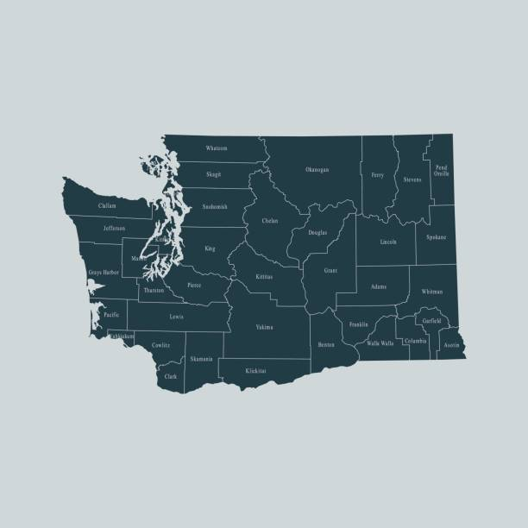
Local Rules Opportunity
County by County approach
Model local rule for removal and grievance of Dependency VGAL/CASAs
Notes:
“Each court shall promulgate rules that set out or refer to policies and procedures establishing and governing the filing, investigating, and adjudicating grievances made by or against guardians ad litem under Titles, 11, 13, and 26 RCW.” GALR 7
Grievances must be recorded. GALR 7 (h). Removal of registry must be reported twice annually to AOC. GALR 7 (i).
“Implementation. Local court rules establishing a grievance procedure shall be filed in the manner provided in GR 7.” GALR 7 (j).
No local rules for Title 13 GAL and CASAs: Adams, Douglas, Grant, Kittitas, Lincoln, Mason, Pacific/Wahkiakum, Pierce, Skagit, Snohomish (non-atty VGALs only), Spokane, Walla Walla, Whatcom, and Yakima

Slide 39
Ms. D’Adre Cunningham
WDA IPP Resource Attorney
dadre@defensenet.org
Nancy Talner
American Civil Liberties Union of Washington Staff Attorney
talner@aclu-wa.org

